Slide 1

Optimizing the time over target for a satellite in a natural orbit
What, How, and Why

Slide 2
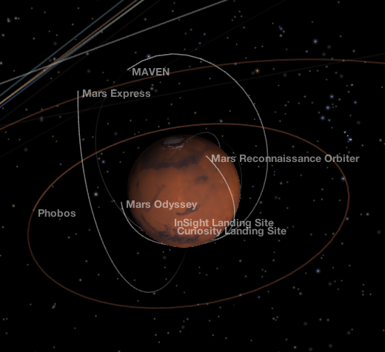
Problem
Satellites are often designed to fly over specific ground targets, but only fly over those targets for short periods of time. Such satellites include communications satellites, remote sensing satellites or research satellites. Increasing the time they spend over their targets increases the potential of the mission.

Slide 3
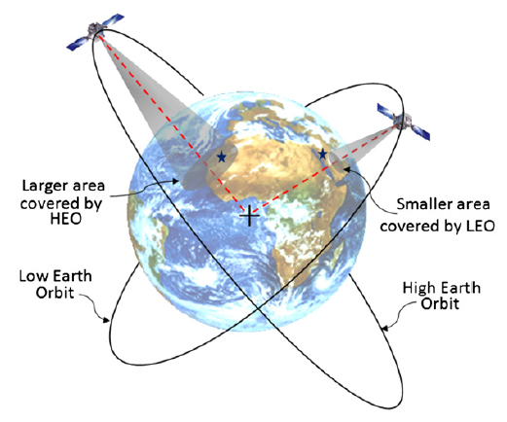
Approach
Utilize genetic algorithms to optimize a set of satellite orbits in a way that maximizes the amount of time each ground target spends in the satellite’s field of view

Slide 4
Initialization
Create an initial population of solutions that will be optimized
Selection
Select for optimum solutions using a fitness function. Can use mutation or gradient ascent to optimize solutions.
Termination
Can be terminated after fitness of solutions is seen to level out.
Methodology

Slide 5
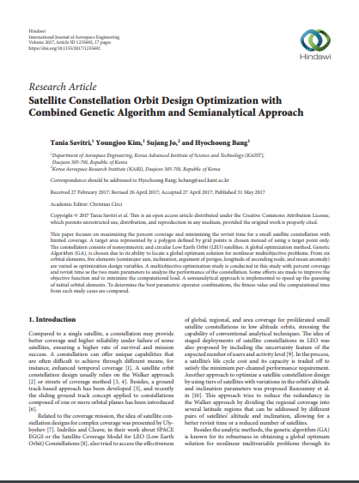
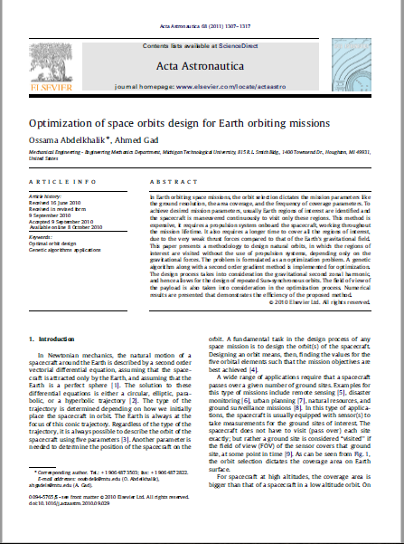
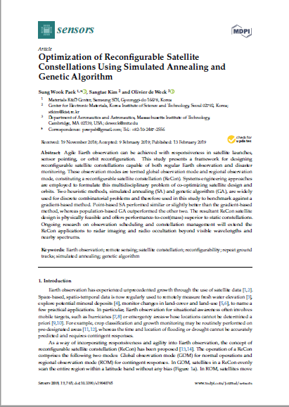
Present Research

Slide 6
Citations
Hussey, K., Kulczycki, S., & Wesson, A. (2010). NASA’s Eyes [software]. Available from https://eyes.nasa.gov
Abdelkhalik, O., & Gad, A. (2011). Optimization of space orbits design for Earth orbiting missions. Acta Astronautica,68(7-8), 1307-1317. doi:10.1016/j.actaastro.2010.09.029
Paek, S., Kim, S., & Weck, O. D. (2019). Optimization of Reconfigurable Satellite Constellations Using Simulated Annealing and Genetic Algorithm. Sensors,19(4), 765. doi:10.3390/s19040765
Savitri, T., Kim, Y., Jo, S., & Bang, H. (2017). Satellite Constellation Orbit Design Optimization with Combined Genetic Algorithm and Semianalytical Approach. International Journal of Aerospace Engineering,2017, 1-17. doi:10.1155/2017/1235692

